Slide 1
Design Patterns
Presented by Mahmoud Ahmed

Slide 2
Agenda
Factory pattern
Composite pattern
Iterator pattern
Visitor pattern

Slide 3

Factory Pattern

Slide 4
Factory Pattern
The Factory Method is a creational design pattern that defines an interface for creating objects but lets subclasses decide which object to instantiate. It promotes loose coupling by delegating object creation to a method, making the system more flexible and extensible.

Slide 5
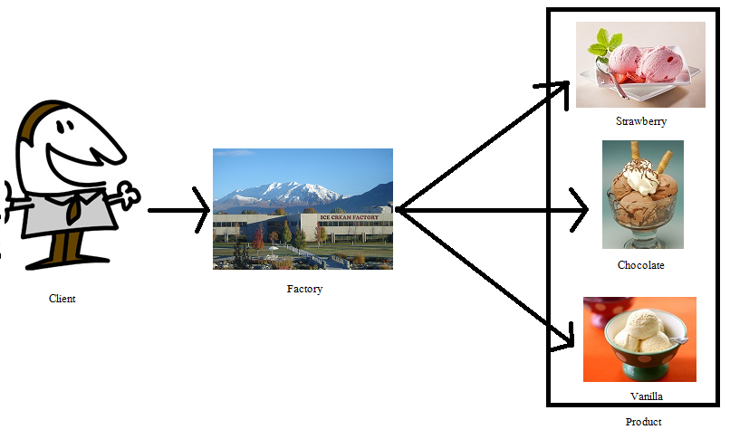

Slide 6

Hands-On #1
There is 3 Pizza restaurants to make 3 different types of pizza (Margarita, Peperoni, Mozzarella) but they all get the Pizza from the same restaurant

Slide 7

Composite Pattern

Slide 8
Composite Pattern
The Composite Pattern is a structural design pattern that organizes objects into tree structures, enabling clients to treat individual and composite objects uniformly through a common interface.

Slide 9
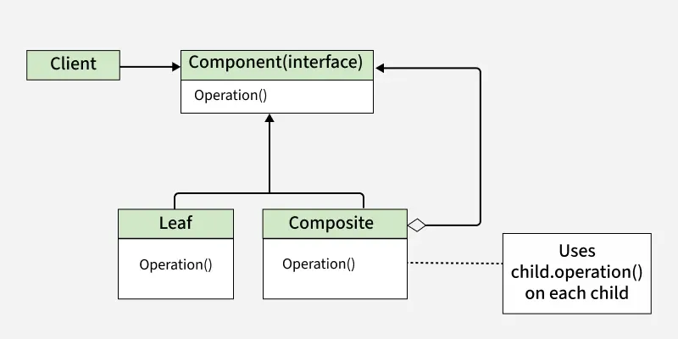

Slide 10
Disadvantages of Composite Design Pattern
Complex Implementation: Requires a common interface for all objects, making code more intricate.
Performance Overhead: Traversing deep hierarchies can slow operations.
Limited Type Safety: Common interface may allow invalid operations, risking runtime errors.
Reduced Clarity: Code can become harder to understand in complex structures.
Extra Memory Usage: Storing child references increases memory consumption.

Slide 11
Break 15 Minutes

Slide 12

Iterator Pattern

Slide 13
Iterator Pattern
The Iterator design pattern is a behavioral design pattern that provides a way to access the elements of an aggregate object (like a list) sequentially without exposing its underlying representation. It defines a separate object, called an iterator, which encapsulates the details of traversing the elements of the aggregate, allowing the aggregate to change its internal structure without affecting the way its elements are accessed.

Slide 14
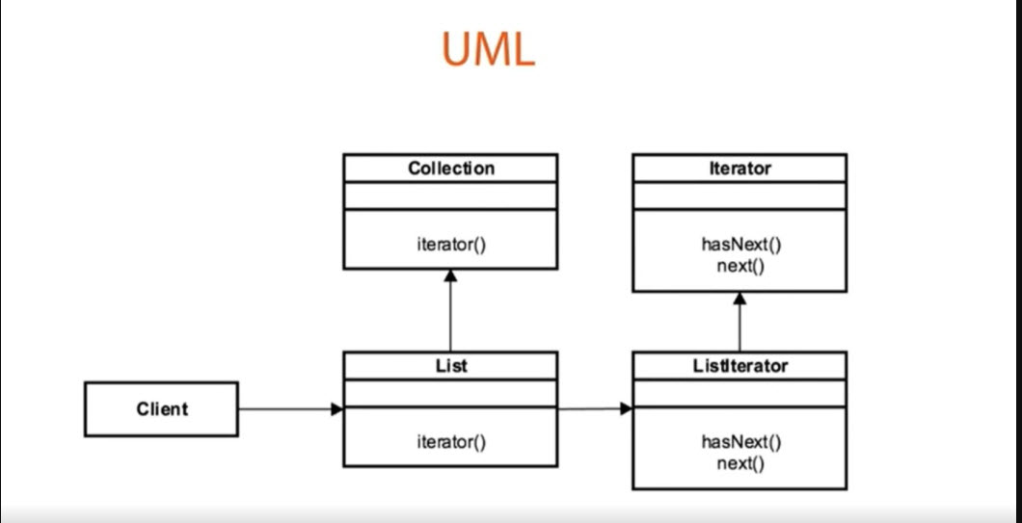

Slide 15
When to use Iterator Design Pattern
Need for sequential access: Use the Iterator pattern when you need to access elements of a collection sequentially without exposing its underlying representation.
Decoupling iteration logic: Use the Iterator pattern when you want to decouple the iteration logic from the collection.
Support for multiple iterators: Use the Iterator pattern when you need to support multiple iterators over the same collection.
Simplifying client code: Use the Iterator pattern to simplify client code that iterates over a collection.

Slide 16
References
https://www.geeksforgeeks.org/system-design/iterator-pattern/

Slide 17

Visitor Pattern

Slide 18
When to use Design Pattern
You need to add new operations frequently
You want to avoid modifying existing classes

Slide 19
Visitor Pattern
The Visitor design pattern is a behavioral pattern that allows you to add new operations to a group of related classes without modifying their structures. It is particularly useful when you have a stable set of classes but need to perform various operations on them, making it easy to extend functionality without altering the existing codebase.

Slide 20
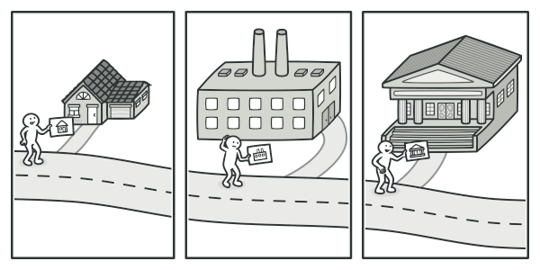

Slide 21
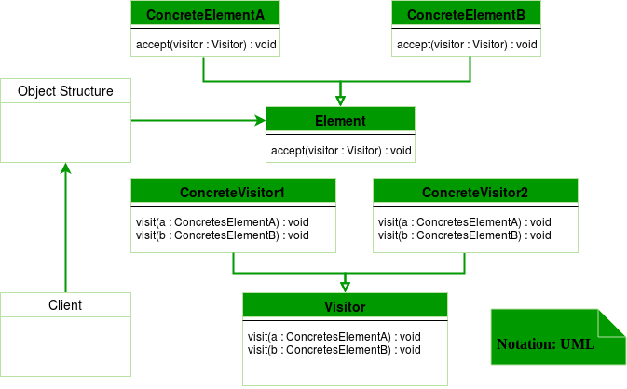

Slide 22
Pros of Visitor Design Pattern
Separation of Concerns: This pattern keeps operations separate from the objects themselves, making it easier to manage and understand the code.
Easy to Add New Features: You can introduce new operations simply by creating new visitor classes without changing the existing objects. This makes the system flexible.
Centralized Logic: All the operations are in one place (the visitor), which helps you see how different tasks interact with your objects.
Easier Maintenance: If you need to update or fix something, you can do it in the visitor class without touching the object classes, making maintenance simpler.
Type Safety: Each visitor method is specific to an object type, which helps catch errors early and ensures the right operations are applied.

Slide 23
Cons of Visitor Design Pattern
Added Complexity: It can make your code more complicated, especially if you have many types of objects or operations to manage.
Challenging to Add New Objects: While adding new operations is easy, introducing new types of objects requires changes to all visitor classes, which can be a hassle.
Tight Coupling: Visitors need to know about all the specific object types, which can create a dependency and make your design less flexible.
More Classes to Manage: This pattern can lead to a lot of extra classes and interfaces, which can clutter your codebase and make it harder to navigate.
Not Ideal for Frequent Changes: If your object types change often, the Visitor pattern can become a burden, as you'd need to update multiple visitor classes each time.

Slide 24
References
https://www.geeksforgeeks.org/system-design/visitor-design-pattern/

Slide 25
Thank you

